Slide 1
Governance and Compliance
GRC Unit, Day 3

Slide 2

Class Objectives
By the end of today’s class, you will be able to:
Explain how organizations use policy and procedure to formalize standards of “right” and “wrong”.
Use governance frameworks to determine which policies an organization must develop.
Explain how audits are used to ensure compliance.
Develop business continuity and disaster recovery plans.

Slide 3
DAY 1
Structure of the security and the importance of a strong security culture
DAY 2
Threat Modeling and Risk Analysis
Notes:
11. Instructor Do: lesson plan pg. 32

Slide 4
Governance and Compliance
Today we will cover governance, compliance, and business continuity planning and disaster recovery.
Codifying and enforcing proper behavior and operations, i.e. establishing standards of “right” and “wrong”, and enforcing those standards.
Enforcing the policies in order to meet those standards.
Governance
Compliance

Slide 5

Knowledge of governance, compliance, and BCP/DR is crucial context for all security professionals because most of security professionals work is mandated by governance policies and subject to compliance audits.
Notes:
Image source: shutterstock_664638928

Slide 6
Class Breakdown
Today’s class will proceed as follows:
01
Codifying Rules with Policy and Procedures
02
Using Governance Frameworks to Guide Policy Decisions
03
Understanding Audit and Compliance
04
Business Continuity Planning and Disaster Recovery
05
Developing BCP/DR Recommendations for an Organization

Slide 7
Codifying and Enforcing Behavior with Policies and Procedures

Slide 8
Review: This week we developed a training plan to improve GeldCorp's security culture.
This training plan was meant to protect the organization by changing employee behavior.
It defined the policy or“right behavior”; i.e. what employees should do when faced with suspicious links

Slide 9
Policy <> Frameworks <> Compliance <> Audits
How are they connected?
Organizations use policies to define standards for behavior and operations.
Each individual policy is just one rule amongst many. In practice, organizations will have many policies to support a given goal. For example, a company must have many security policies in place to protect its data.
Guidelines for which kinds of policies an organization should have in place are called governance frameworks.
Governance frameworks describe which guarantees a company must provide to remain compliant with federal regulations and industry standards.
Audit is the process of checking whether an organization is compliant with a given framework or guideline

Slide 10
Today’s Scenario
In today’s activities, we will:
Define formal policies for GeldCorp
Assess what user data collected by GeldCorp is subject to GDPR and PCI
Determine whether GeldCorp's data collection practices are GDPR and PCI compliant

Slide 11
Refresher on our GeldCorp Training Plan
We developed our training plan by setting a goal, and determining the necessary steps to achieve it.
The training plan prescribed a specific rule employees should follow: Do not click on links to domains outside of the corporate intranet.
This rule is an example of a policy, which is a course or principle of action proposed by a business. In this case, the rule specifies a download policy.
The goal of defining and implementing a new download policy was to reduce employee click-through rate to less than 5%. In other words, the business implemented policy as a means of achieving this goal.

Slide 12
Business Goals Often Drive Policy Implementation
Two Categories of Business Goals
Internal/ Volitional
External/ Imposed
Targets that the business sets in its own interest.
For example, an organization might aim to reduce long-term security expenses to less than $400,000.
These are targets that the business must hit because they will suffer consequences if they do not.
Examples include the requirement that emerchants handle all credit card transactions securely, under penalty of law in the event of a breach of customer PII.

Slide 13
Internal Objectives and Policy
Example: Reduce unauthorized root-level login incidents on Domain Controllers to 0.
Goals which are not required by any external organization or actors
An organization would hand this off the IT team, who would be responsible for determining how best to implement it.
One possible implementation is to require all Domain Administrators to use strong passwords, and force them to create a new password every month.

Slide 14
Password Policy
A password policy might require that Administrators create passwords with:
At least 16 Characters
At least 1 Letter and 1 Number
At least 1 Special Character (', (, ], etc.)
No portion of the administrator's username
Passwords are also updated every month

Slide 15
This policy defines clear standards of behavior: Administrators are expected to follow very specific rules with regard to their passwords, which their computers will enforce. These rules are also specifically designed to achieve the goal of reducing the incidence of unauthorized root-level logins on Domain Controllers to 0.

Slide 16
Password Policy Example (Part 1)
CONFIDENTIAL DOCUMENT
DATE: 5/17/2017
AUTHOR: Jane Author
DOMAIN ADMINISTRATOR PASSWORD POLICY
This document lays out a password policy for Domain Administrators.
PURPOSE
The purpose of implementing a Domain Administrator password policy is to reduce the incidence of unauthorized root-level logins on Domain Controllers.
The organization has prioritized this objective in the interest of protecting the integrity and confidentiality of data on the corporate intranet.

Slide 17
Password Policy Example (Part 2)
CONFIDENTIAL DOCUMENT
POLICY DESCRIPTION
Domain Administrators will be required to create a new strong password every month. This password MUST NOT include any substring of the Domain Administrator's username.
In addition, the password must include:
- At least 16 Characters
- At least 1 Letter and 1 Number
- At least 1 Special Character (`'`, `(`, `]`, etc.)
For example, the following passwords are legal for the user `guest`:
- `CloGyPTioNEntEDist`
- `CloGyPTioNEntEDist`
- `n0tparticularly!strong`
The following password is illegal:
- `gue1st12345678901342`

Slide 18
Password Policy Example (Part 3)
CONFIDENTIAL DOCUMENT
ENFORCEMENT
All workstations on the corporate domain have been configured to force Administrators to adhere to the above password complexity constraints and refresh intervals.
Non-compliant passwords will be rejected by the operating system.
MONITORING
All attempts to log in as a Domain Administrator—both remote and local—will be monitored.

Slide 19
Documenting Company Policies In the previous lesson, you performed a risk analysis to help GeldCorp gain visibility into its most prominent threats. Since then, they've used your results to set numerous internal security goals.
In this exercise, you will help them realize these goals by developing and documenting policies to support them.
15 minutes

Slide 20
Your Turn: Password Policy
Assignment:
Work in pairs on creating a policy for the below internal goal and don't hesitate to ask your instructional staff and/or classmates for help if you get stuck.
Internal Goals
Eliminate tailgating at all main offices.
Note: Tailgating is when an employee holds the door open for others, thus allowing them to enter the building without scanning their ID.
Guarantee 99% uptime for all trading applications.
Reduce incidence of developers accessing customer PII that they don't need for their projects.

Slide 21
Your Turn: Password Policy
Password Policy Template:
DATE:
AUTHOR:
<Policy Name>
PURPOSE
What security benefit does this policy bring?
DESCRIPTION OF <Policy Name>
What are the terms of the policy?
ENFORCEMENT
How will this policy be enforced?
MONITORING
How will the effectiveness of this policy be measured?

Slide 23
Using Framework to Guide Policy Development

Slide 24
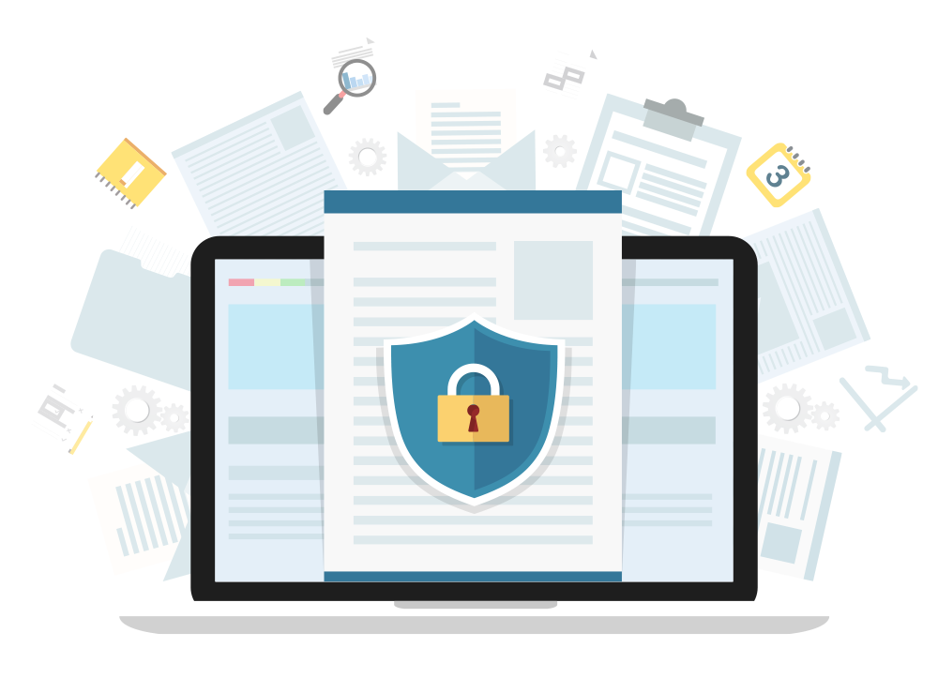
Internal Objectives and Policy
Businesses often have to follow rules in addition to those they set for themselves. These rules don’t directly benefit the business, but might be mandated by the law or industry standards.
Example: Merchants that process financial transactions are legally required to guarantee that their customers’ data remains confidential. If a company suffers a breach that results in the disclosure of customer PII, they may be subject to fines and other legal penalties.
Notes:
Image source: shutterstock_505694416

Slide 25

Governance Frameworks
These rules that everyone should follow are often described as policies that everyone should have in place.
Such prescriptions of which rules an organization should follow are often called governance frameworks.
Frameworks can be:
Internal (Developed by the company)
External (Developed by standards bodies or governments)
Notes:
Image source: shutterstock_1330359209

Slide 26

SEC
These frameworks have their origins in statutes adopted by the Securities and Exchange Commission (SEC), the regulatory body in charge of enforcing and proposing laws regarding financial instruments (stocks, bonds, options, etc.), and protecting consumers from fraud.
During the 90s, the SEC worked with Congress to pass anti-fraud statutes to discourage many incidents of cybercrime.
In 2000, the SEC moved past simple anti-fraud laws by adopting a regulatory statute called Regulation S-P.
Notes:
Image source: shutterstock_376748761

Slide 27

Rule 30 of Regulation S-P (Safeguard Rule)
In 2000, the SEC moved past simple anti-fraud laws by adopting a regulatory statute called Regulation S-P. This regulation did not focus entirely on security, but Rule 30 of Regulation S-P mandated that organizations establish written policies and procedures that are designed to:
Insure the security and confidentiality of customer records and information.
Protect against any anticipated threats or hazards to the security or integrity of customer records and information.
Protect against unauthorized access to or use of customer records or information that could result in substantial harm or inconvenience to any customer.
Notes:
Image source: shutterstock_1330359557

Slide 28

Regulation S-AM (August 2009)
Regulation S-AM placed limits on when corporations could share consumers' private information for advertising and marketing purposes.

Slide 29
Disclosure Guidance (October 2011)
On October 13 2011, the SEC issued guidelines for when and how organizations should disclose breaches of cybersecurity. While not formal regulatory statutes with the force of law, these guidelines mark an important step towards cyber regulation.
When the guidelines were released, the federal government still had no formal regulations around cybersecurity or cyber incidents, but the disclosure guidance specified that businesses were still obligated to disclose cybersecurity breaches under then-current SEC rules, if the breach resulted in the disclosure of information that a ""reasonable investor would consider important to an investment decision".

Slide 30
Regulation S-ID (April 2013)
Also known as Identity Theft Red Flags Rule
Regulation S-ID laid forth "final rules and guidelines to require certain regulated entities to establish programs to address risks of identity theft."
First regulation to formally require corporations to protect consumers' Non-Public Information (NPI).
Regulation S-ID obligates firms to do two things:
Protect against identity theft
Verify that requests to change an account holder's registered address indeed come from the account holder themselves.

Slide 31
Cybersecurity Regulation Blueprint (April 15 2014)
The SEC officially recognized cybersecurity as an exam priority, meaning that they would consider a firm's security posture as a routine part of their evaluations and audit standards.
The blueprint provides examples of the kinds of questions the SEC would ask brokerages and asset managers during audits.
Though these statues, regulations, and guidelines were developed for financial institutions, they apply to all publicly traded organizations, regardless of industry.
While they explain what kinds of protections companies are obligated to provide their customers, they do not specify how they should meet those obligations
Governance frameworks codify standards that all businesses should follow. Since businesses in different industries manage different kinds of data, there are different frameworks for different industries.

Slide 32
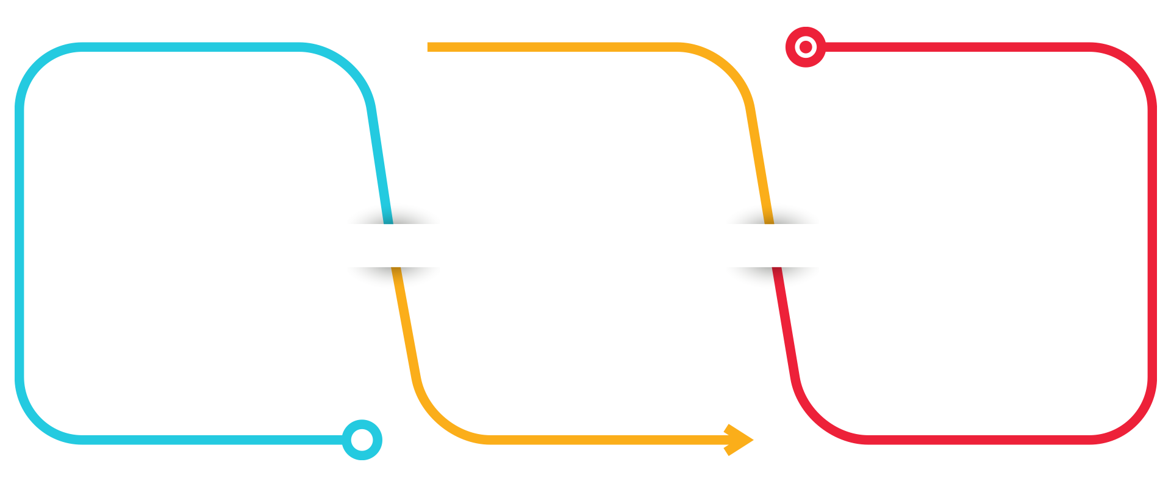
Common Governance Frameworks
All security professionals must be familiar with the following, at minimum:
General Data Protection Regulation (GDPR)
protects the private data of all citizens of the EU and European Economic Area (EEA).
Health Insurance Portability and Accountability Act (HIPAA) mandates the protection of medical information.
Payment Card Industry Data Security Standard (PCI DSS) establishes guidelines that all companies that handle credit card transactions do so securely.
Notes:
Image source: shutterstock_1135646558

Slide 33
GDPR
It requires that organizations that process data belonging to EU citizens protect the data sufficiently.
GDPR regulations apply to organizations based in the EU, as well as those based elsewhere that process data belonging to EU citizens.

Slide 34
HIPAA
Title II: HIPAA Administrative Specification.
Establishes privacy standards around electronic access to healthcare data. Organizations must uphold the following standards to remain HIPAA compliant:
National Provider Identifier Standard: All healthcare entities (people, healthcare providers, health plans, and employers) must have an ID, called the National Provider Identifier (NID).
Transactions and Code Set Standard: This standardizes health insurance claims.
HIPAA Privacy Rule: Establishes standards protecting individually identifiable health information, such as prescription information and lab results. This defines what data to protect.
HIPAA Security Rule: Sets standards for patient data security. This defines how well data should be protected.
HIPAA Enforcement Rule: Establishes guidelines for investigations of non-compliant providers.

Slide 35
PCI
It is an organizational standard, and applies to both public and private organizations that accept, transmit, or store credit card data.
PCI defines different compliance "levels".
Companies that handle many transactions must have a stricter level of compliance than smaller ones.
The most important data protected by PCI includes:
Cardholder Name, Expiry Date, and 3-Digit Service (CVV) Code
Magnetic Strip Data
PIN Numbers

Slide 36
Frameworks mostly describe which policies organizations should have in place, but do not specify how they should implement them.
A business's internal policies document how they choose to implement these mandates

Slide 37
GDPR Compliance
In this exercise, you'll explore the GDPR framework, and determine which data managed by GeldCorp is subject to its regulations.
15 minutes

Slide 38
Compliance and Audit

Slide 39

Compliance and Audit
Business must enforce policies in order to guarantee compliance with legal matters.
An audit is the process of checking how well an organization is adhering to its policies.
Audits are typically conducted to ensure that an organization does indeed uphold the statutes required of it by government frameworks.
Notes:
Image source: shutterstock_727498156

Slide 40

Performing an Audit
Auditors refer to each rule in the framework, and check that the business is following it.
If they find that the organization is in violation of a given mandate, they notify the Compliance/Legal and Executive teams in a final report.
In the event a business is found to be non-compliant in any way, the organization will typically respond by:
Acknowledging that they are aware of the non-compliance
Determining a timeline to remediate the issue
Develop a plan to bring the organization back into compliance
Notes:
Image source: Jerry Low

Slide 41
Audit Procedures
In this exercise, you'll review how GeldCorp's collects and stores user data to ensure their processes are GDPR compliant. In addition, you'll identify any data that must be protected according to PCI standards.
If you identify any incidents of non-compliance, you'll document a way for the organization to bring itself in line with regulation.
15 minutes

Slide 42
Contingency Planning for
Business Continuity
and
Disaster Recovery

Slide 43
Preparing for Breaches
Businesses engage in contingency planning to "plan for the worst"
A breach can have one of two results:
Mild/Moderate Breach: The business has been impacted, but can still handle day-to-day operations at greater cost.
Serious/Catastrophic Breach: The business has been impacted so severely they cannot operate. Instead, they must use their resources to contain the incident, recover from the disaster, and eventually return to operation.

Slide 44
BCP/DR Plans Typically Involve the Following:
Points and Modes of Failure: Places where security is weak, or points of failure in a system like a network.
Projected Damages: How a business will be affected in the event a given threat is realized.
Continuity/Recovery Plan: For BCP, how the business could "patch" a mild/moderate incident to maintain operations during. For DR, explain how the business should prioritize its resources to recover from the reputational and operational damage of a catastrophic loss.
These plans will be different for every business.

Slide 46
Presentations
In this exercise, you'll work in groups to develop BCP and DR plans for Geldcorp. You'll work with a group of consultants, and each group will develop a plan for a different domain of the company.
In particular, you'll develop plans for one of the following realms:
Physical Environment
Personnel
Network
Technology
Security
1hr 30 minutes

Slide 47
Presentation Time!

